Slide 1
Translation Stage System
TAO SiPM mass testing
masi@ihep.ac.cn

Slide 2
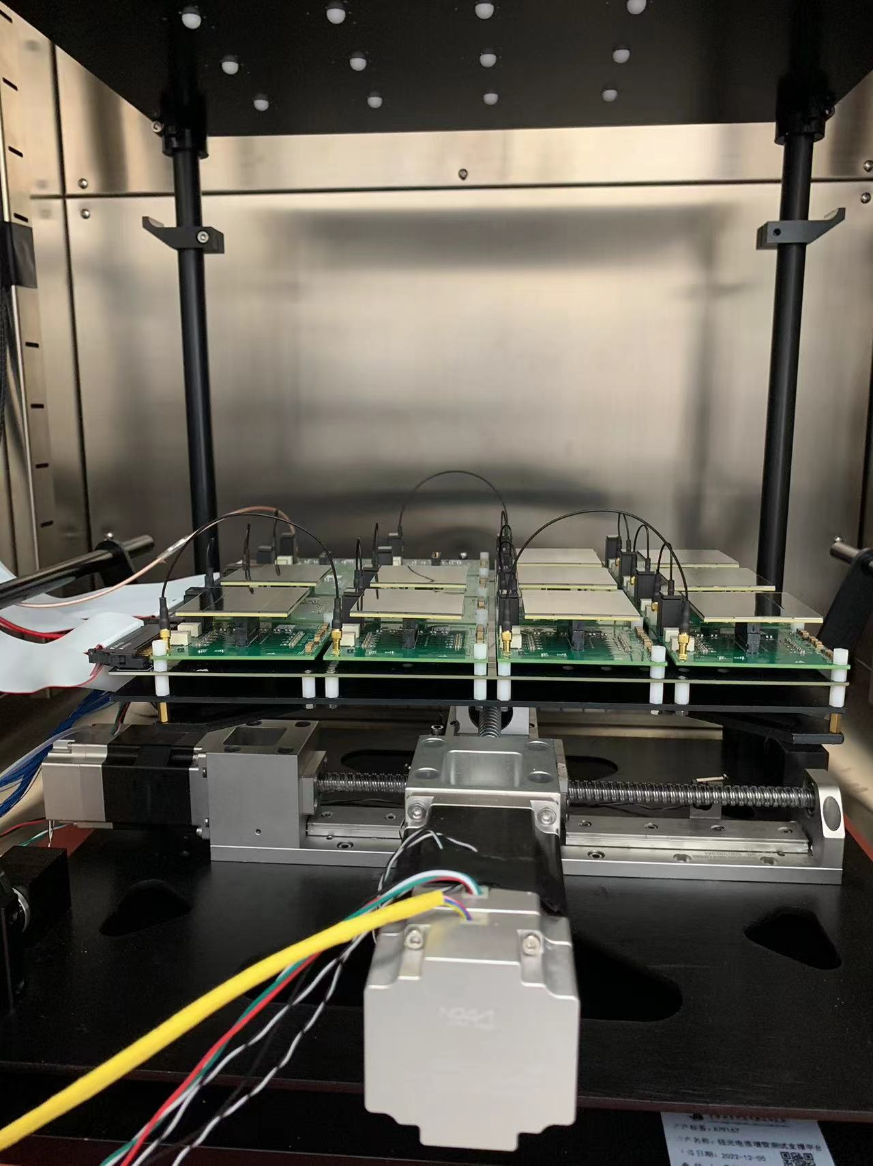
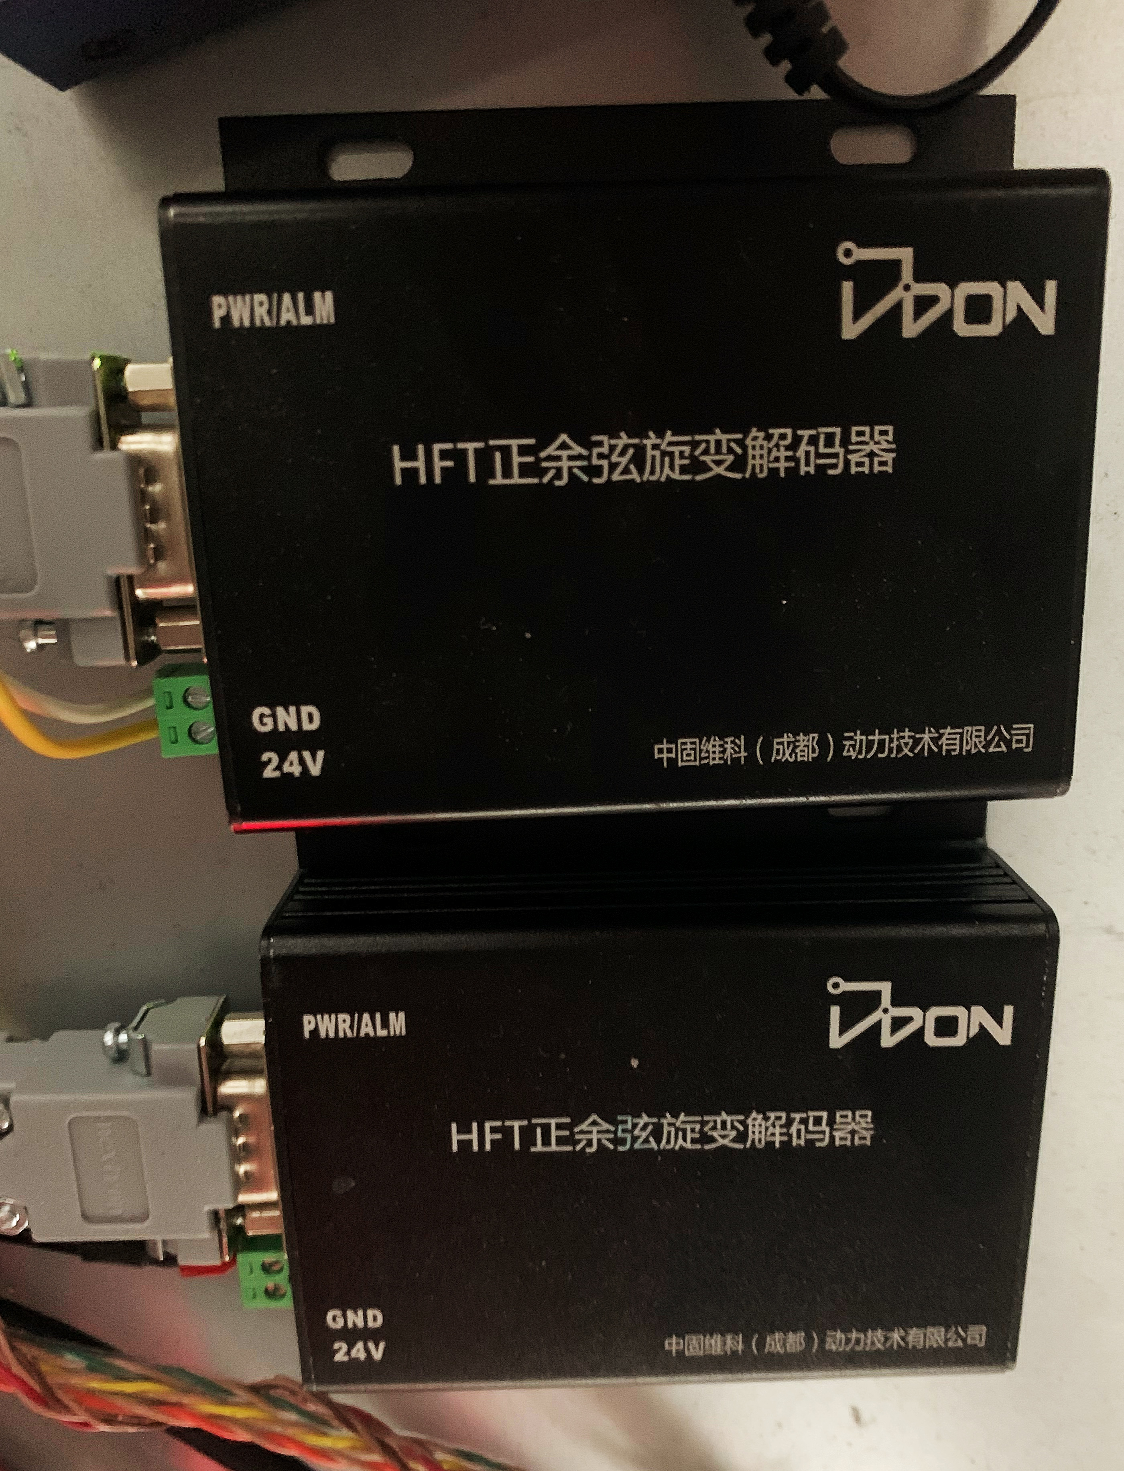
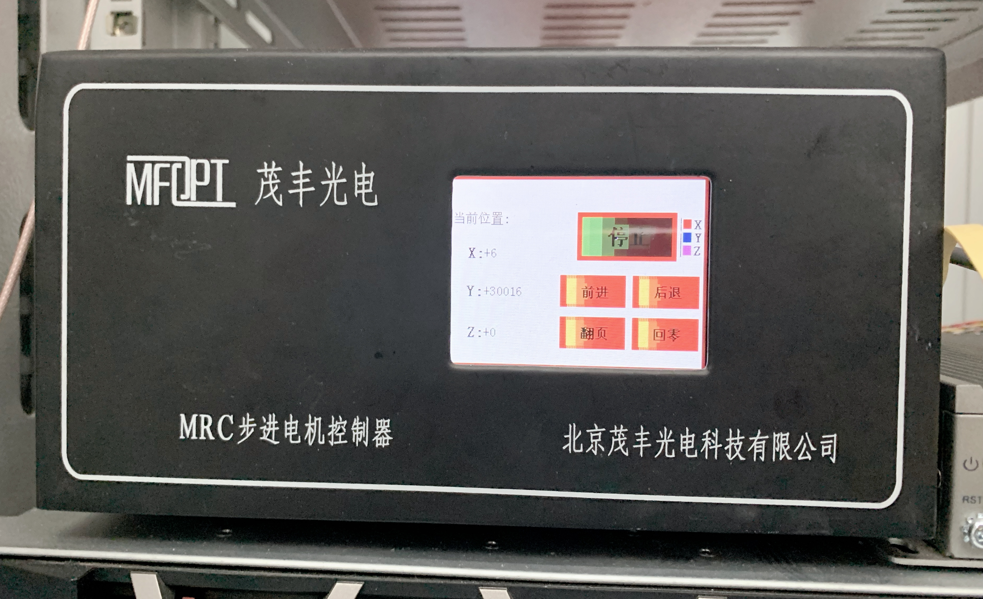
Devices of TSS
decoders
encoders
Y-rail
Device | Type | Number | Work temperature
slide-rail | VC60-200-5 | 2 | -50˚C ~ 85˚C
step motor | HS5776A-FK | 2
encoder |  | 2
decoder | HFT (12bit) |  | room temperature
driver | HD265 | 2
controller | MRC | 1
motors
X-rail
controller
& drivers

Slide 3
Device Introduction
Controller & driver
Control the movement of two motors in sequence.
Driver subdivision can be set to determines the number of pulses required for one cycle. Now the subdivision is set to 1600pulses/cycle.
Decoder
Used to check the real position of the carrier.
Value range:
[0, 4095] for one cycle
(-2147483648, 2147483647) for cycles

Slide 4
Data transmission
Between controller and computer
RS232 serial communication
Between decoder and computer
RS232 serial communication

Slide 5
TSS control & monitoring software
PyQT5-based development
Requires: python 3.9 or later, pyserial, pyqt5
The software provides two user interaction modes:
Graphic user interface (GUI) interact mode
Easy to use
Command line interact mode
Efficiently to integrate

Slide 6
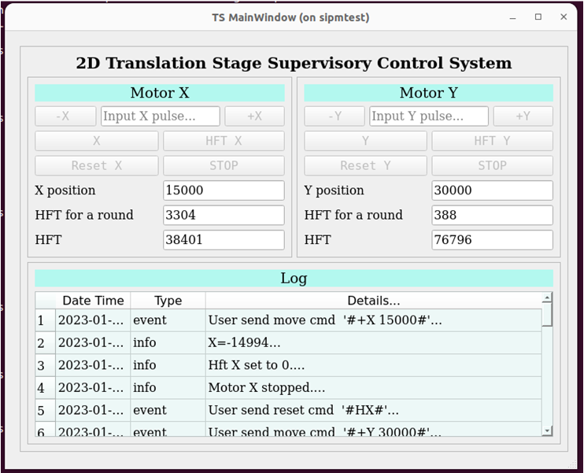
TSS GUI

Slide 7
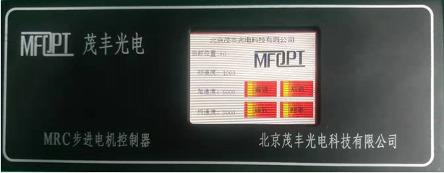
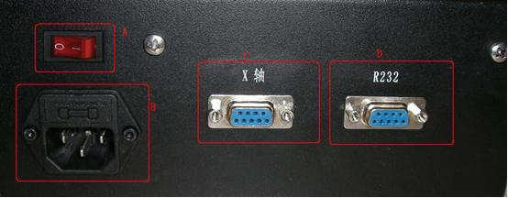
Additional instructions ---MRC(1)
Front View:
2.8 inch touchable LCD screen
Real time display current position, initial velocity, acceleration and final velocity
Provide 4 shortcut keys, forward, backward, run and return to zero
Forward: for each press, advance 10000 pulses
Backward: for each press, go back 10000 pulses
Return to zero
Run: run the program, which already stored in flash.
Rear View:
Power Switch
220v power socket
X-axis motor and hardware limit switch interface
RS232 communication and hardware IO output interface

Slide 8
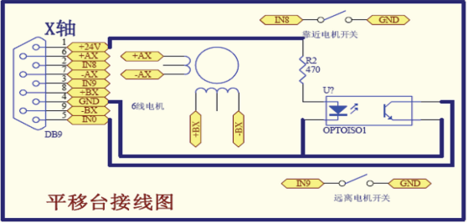
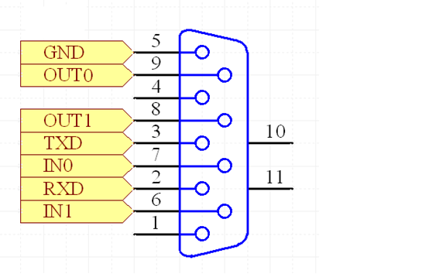
Additional instructions ---MRC(2)
X-axis motor and hardware limit switch interface diagram
RS232 communication and
hardware IO output interface diagram

Slide 9
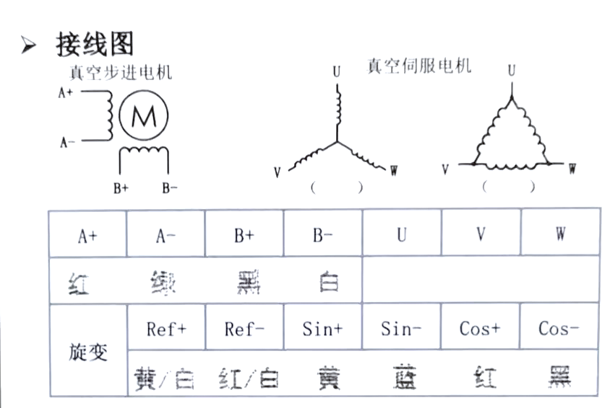
Additional instructions ---Motor
Motor and driver,
encoder and decoder wiring diagram

